Slide 1


AngularJS: Introduction
Presented by : Komal Kadam
Email : komalka@cybage.com Extn. 8032
This document and all its contents contain information from Cybage Software Private Limited which may be privileged, confidential, or otherwise protected from disclosure. The information is intended to be for the addressee(s) only. Any unauthorized disclosure, copy, distribution, or use of the contents of this message is strictly prohibited.

Slide 2
Agenda
What is AngularJS?
Why AngularJS
Dynamic websites and SPAs
Some MV* architectures
Getting Started
Modules
Templates
Expressions
Example

Slide 3
What is AngularJS?
AngularJs is a JavaScript based MV* or MVW structural framework developed by Google to build properly architectured, maintainable, optimized and highly testable web applications.
Creator: Misko Hevery
1st release: v1.0.0 in 2012
Current Stable release : 1.5.0
Written in : JavaScript
Operating system : Cross Platform
Size: Development : 933KB Production : 123KB
Open Source

Slide 4
Why AngularJS?
Template : Written in html that contains angular specific elements and attributes.
Data Binding : Two way databinding.
Filters : data transformation
Dependency Injection : To manage the responsibility of dependency creation.
Services : Services are singleton objects.
Directives : Reusable components , Create custom tags, attributes
Good for SPAs

Slide 5
Dynamic Websites and SPAs
Dynamic websites add to user interactivity
e.g. Cybintranet is a Dynamic website
But there is a concern with the server round trip when generating views for a model
So SPA’s i.e. Single Page Applications come to rescue in terms of Server Round Trip

Slide 6
Common Approaches:
To add Dynamicity to any website the following may be commonly used approaches:
Using a Library: like JQuery
Using a Framework : Durandal, EmberJs, AngularJs etc..
Out of which AngularJS is gaining a lot of popularity for SPAs

Slide 7
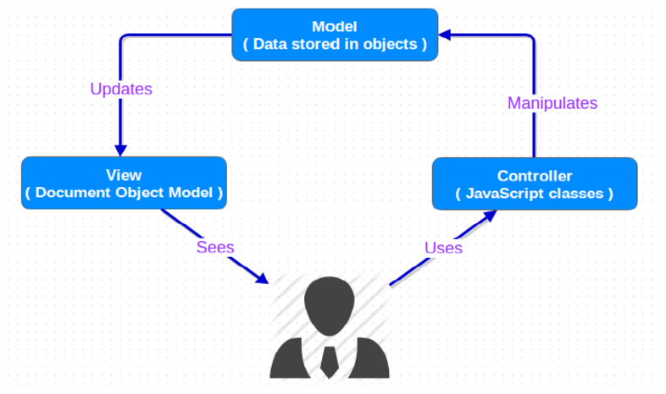
Some MV* Architectures:
MVC:

Slide 8
MVVM: Model View ViewModel
View
ViewModel
Model
User actions, commands
Data binding
Notifications
Presentation Logic
Data
Data Access
Update ViewModel about change

Slide 9
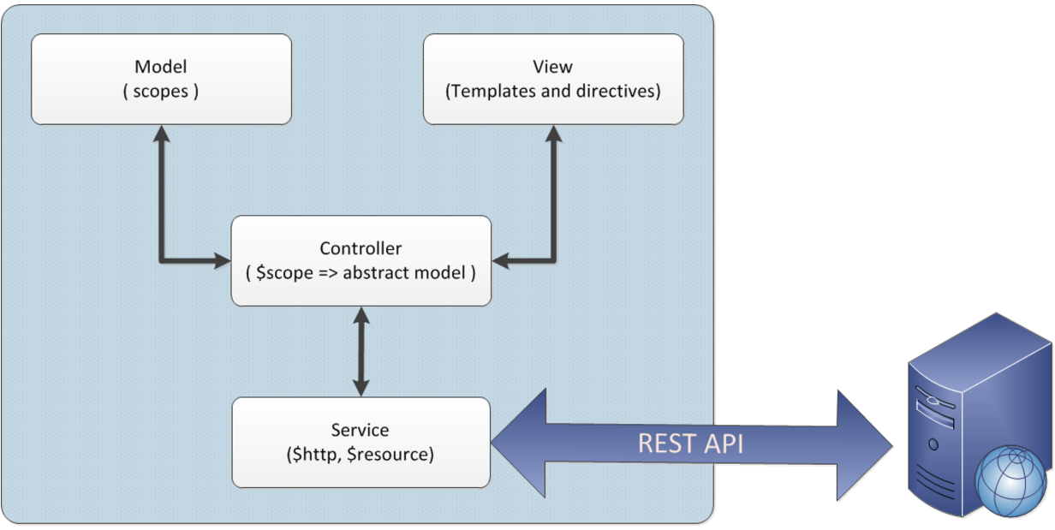
Some MV* Architectures:
MVC2:

Slide 10
Getting Started: Including AngularJs in your Webpage
Bootstrapping (starting AngularJS app in your webpage) :
AngularJS is distributed as a JavaScript file, and can be added to a web page with a script tag: (allows to treat only portion of a DOM as an angular application).
<script
src="https://ajax.googleapis.com/ajax/libs/angularjs/1.3.14/angular.min.js">
</script>
OR
<script src=“path-to-angular.min.js"> </script>

Slide 11
Getting Started: Automatic Bootstrapping
ng-app :
It is a directive to auto-bootstrap an application. Only one ng-app directive can be used per HTML document for Automatic Bootstrapping of an Angular app.
<html ng-app=“ ”>
..
</html>
ng-app="myApp“ : Bootstrap my application using myApp module.

Slide 12
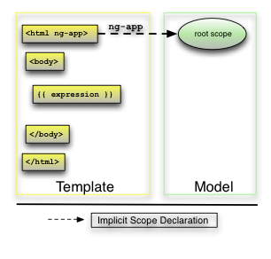
Getting Started: AngularJS separation of MV* layers

Slide 13
Module :
What is a Module?
You can think of a module as a container for the different parts of your app – controllers, services, filters, directives, etc.
Usage:
Modularity
Code Reuse
Easily Testable

Slide 14
Module:
How To Create One?
var module = angular.module(‘appName’,[ ]);
Recommended Usage:
A module for each reusable component (especially
directives and filters)
And an application level module (main module) which
depends on the above modules and contains any
initialization code. (Note : Most applications have main method that instantiates and wires together different parts of application angular has module for the same)

Slide 15
Template :
Simply stated, templates are Html snippets that contains angular specific elements and attributes. No need of classes and ids.
Types of angular elements and attributes:
a) Directive
b) Markup
c) Filter
d) Form Controls

Slide 16
Expressions:
• Angular expressions are JavaScript like code
snippets that are usually placed in double curly
bindings in html i.e. – {{ expression }}
• Some Valid Expressions:
– {{ 1 + 2 }}
– {{ a + b }}
– {{ items[index] }}

Slide 17
Expressions: Properties
Context: Unlike JavaScript, Angular expressions are evaluated against a scope object.
Forgiving: In Angular, expression evaluation is forgiving to undefined and null.
• Control flow (loops, exceptions) are
not supported!
• You can use angular filters to format or filter any data

Slide 18
Example :
Lets have an Example…

Slide 19
Any
Questions?

Slide 20
Thank You!

